Slide 1



Economy: 6 pillars + theory + current + BES17 (pre cum Mains)
1.Banking, Fin, Insur.
6.HRD
2.Budget
3.BoP
4.Sectors
5.Infra
V1:c3,4
V1:c2,3, 6,9,11(GST),13
V1c:5
V1c:7(Textile),11(trade)
V1c:10
v1c:12, 14; Budget^Rail
Agri, mfg, labour laws done. Now in this lecture, ~1 dozen Skill schemes + 1 Make in India.

Slide 2





Why Skill People?
Agriculture: Disguised unemployment ▼
Make in India ▲
65% below 35 age: Reap demographic Div. ▲
% data may be old. Just focus on the ‘theme / objective behind skilling’.
Notes:
Disguised unemployment vs. demographic dividend
Land consolidation => bigger farm => mechanization => agro output ▲
~6 crore worker shortage in 1st world by 2020.
Only 10% of new India workers skilled. (China 50%)
Make in India useless without skilled workers.

Slide 3


Skilling: Challenges
50-90s
Poor return on Education
Mid-2005
English Medium Boom
2020
Will enter in workforce
“Low Skilled” Generation
Till then have to make do with this generation
By “rehabilitating” thru skilling !
Notes:
50s-90s, private return on “Education” was poor.
Recent years, service sector boom => English-medium private school boom
But, These Kids will enter workforce after 15-20 years
Have to ‘rehabilitate’ unskilled workforce generation in the meantime.

Slide 4
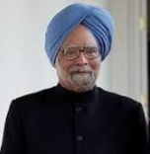

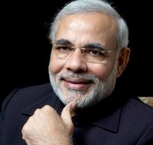
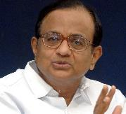
2008: MSME Ministry:Prime Minister’s Employment Generation Programme
Loan subsidy for Micro/> industry.
Khadi and Village Industries Commission as nodal
2011: J&K: NSDC + Home Ministry + corporates = “UDAAN” <too low salaries in placement. So paththrbazi seems a ‘lucrative’ job.>
[don’t confuse with UDAN- Rs.2500 airticket- we’ll study in Avation infra BES17”5”]
Special Ministry for Skill and entrepreneurship
<+ policy in 2015>
2009

Slide 5

2014: Skill India -> 2015: National Skill Mission skill 40 cr Indians by 2022. [farmer income 2x is separate thing.]
2015: before that “STAR” of NSDC
Pradhan Mantri’s Kaushal Vikas Yojana
training: 8k/> stipend + certificate + bank loans. Focus on class 10, 12 dropouts
D D Gramin Kaushal / [Urban] Antyodaya Yojana
Min: Rural Dev, Urban Poverty Alleviation
Training, SHG, cheap loans.
Core Scheme under Skill Ministry [60-40|90-10]
Budget 2017: ~3k cr. [figures not imp for exam.]
<NEXT slide>

Slide 6

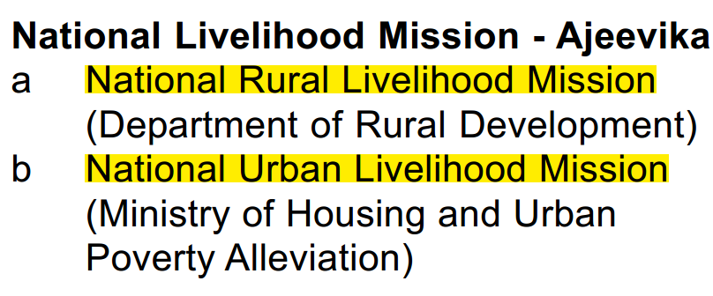

22 Core Schemes: [60:40|90:10]
++ Rural SHG, Bank Loan:
DD ANTYODAYA YOJANA
Rural Skill: Gramin Kaushal Yojana
LWE: Roshni
J&K : Himayat
Urban Skill: Antyodaya Yojana

Slide 7

Who is minority? National Commission for Minorities Act 1992
Parsi,
Jain
Buddhist
Sikh
Christian
Muslim
Hamari Dharohar
Culture preservation
Jio 4g Parsi (2013)
<1 lakh pop ☹
Museum fund
Fellowship research fund..
ART, IVF, infertility treatment
100% CSS
“Core of the Core” Umbrella
“Core of the Core” Umbrella
Increasing Population
Schemes by Minority Affairs Ministry

Slide 8
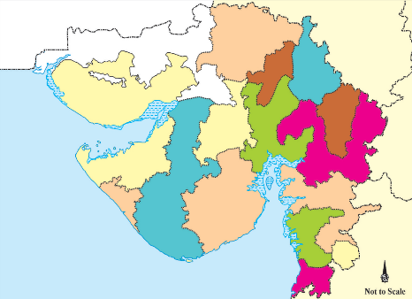
Gujarat State Minority list (commission not setup, although can set up)
Religious
Parsi
Linguistic
Jain
Buddhist
Sikh
Christian
Muslim
Sindhi
Urdu
Marathi

Slide 9
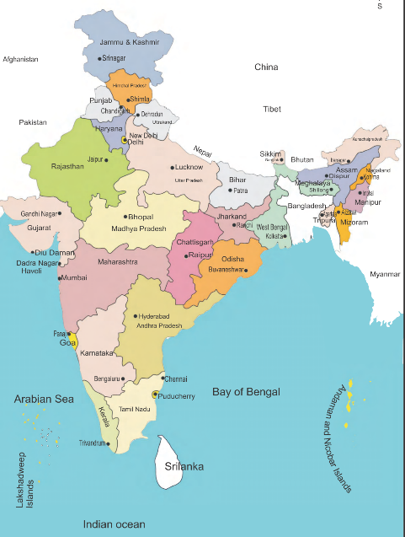
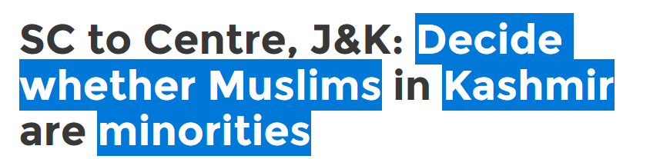
Minority is Majority? [Census 2011]
Justice Sacchar Committee on status of MUSLIMS (2005)
PM 15 Point program (2006)
MINOTIRIES
SIKH (75%+)
Because PIL that Muslims are getting minority scheme benefit in Kashmir
Buddhism (58%)
Notes:
Socio-eco-educational

Slide 10
Hindu Minority? [Census 2011]
Manipur
Arunachal Pradesh
Mizoram
Lakshadweep
Nagaland
Meghalaya
Jammu & Kashmir
Punjab
theHindu columnist=
“minority” in whole world.

Slide 11
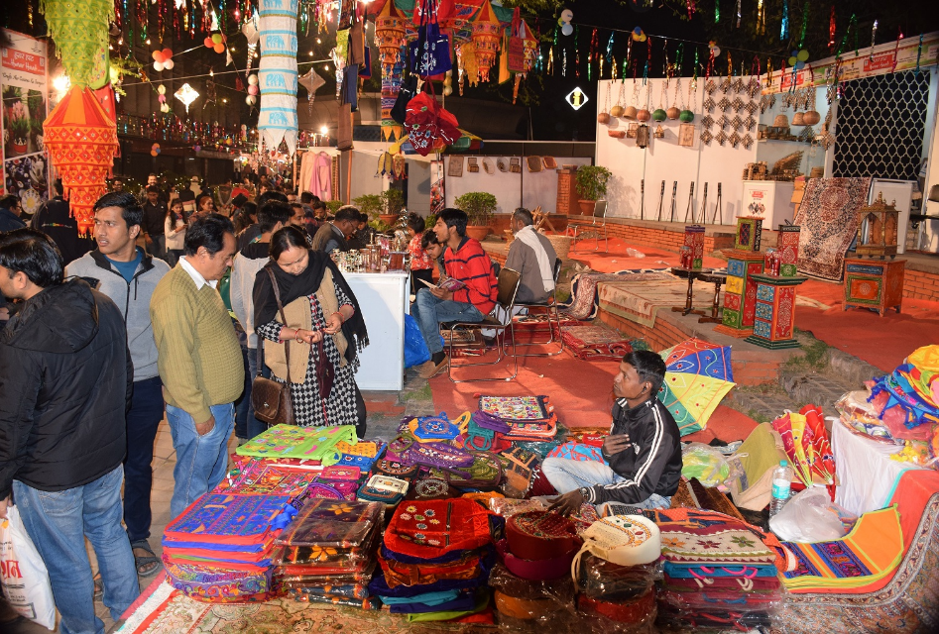

Ustaad: Up gradation of Traditional Skills in Arts, Resources and Goods (2015, Minority Affairs): NID, NIFT, “Hunar Haat”
Kashmiri embroidery
Bengali Muslim: Jardosi embroidery
Sikh- Phulkari embroidery
Buddhist – Thangka painting

Slide 12
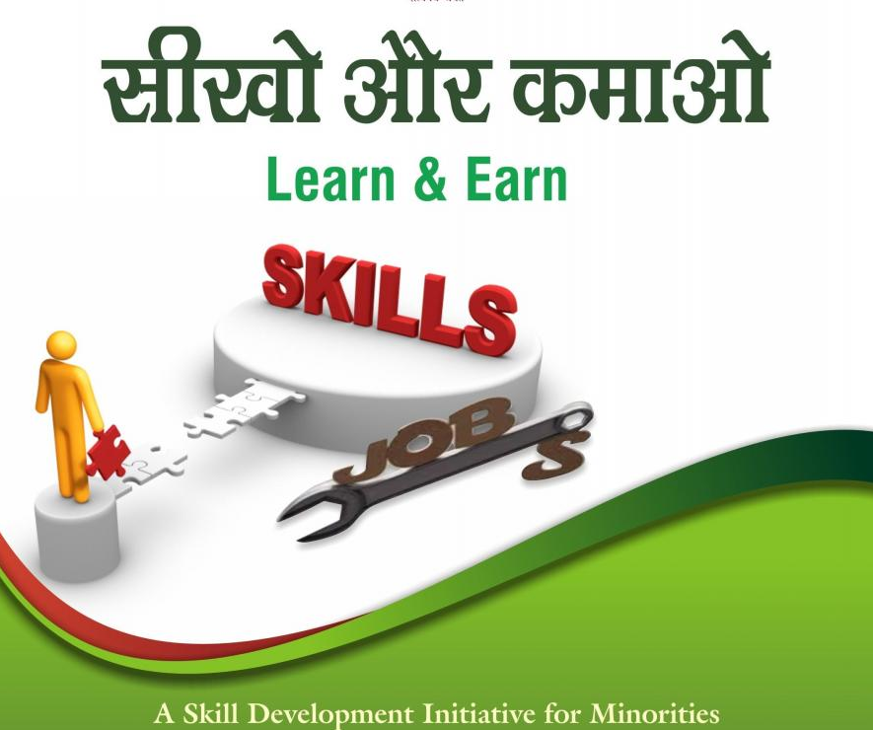
Minority Affairs Ministry -> skilling programs
Nai Manzil
Madressa Passouts given computer, maths, accounting etc skills to get in Mainstream
Sikho aur Kamaao
Private inst. Give computer, tailoring etc skill to minorities
Government reimburses them
Separately: MANAS – Maulana Azad National Academy for Skills (SPV)
Nai Roshni
Leadership among minority women
Higher Education
Padho Pardesh: Loan subsidy for foreign education
Maulana Azad National Fellowship for M.Phil and Ph.D
Think: how can UID help here? Bogus NGOs showing same beneficiaries in their multiple training classes. + need to ‘merge’ Sikho Kamao with DD Gramin Kaushal, Urban Antyodaya for better “Economies of scale” & ▼duplication of effort & stop drudgery of UPSC aspirants in memorizing so many schemes!

Slide 13
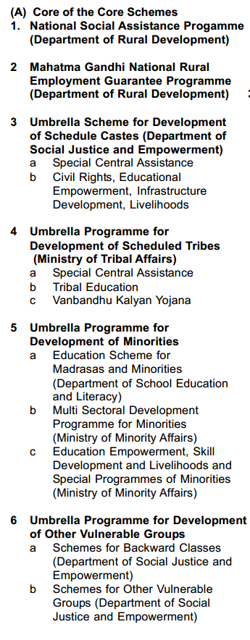
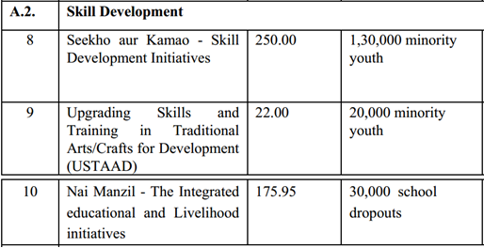
28 CSS=> 6 Core of the Core Schemes
Amount Target
100% CSS

Slide 14
SANKALP & STRIVE
SANKALP: 4k cr.
STRIVE: 2200 cr.
ITI training: make it more industry oriented. Cluster development.
Skill Acquisition and Knowledge Awareness for Livelihood Promotion Programme.
Skill strengthening for industrial value enhancement (STRIVE)
Market relevant training for 3.5 cr youth
Core scheme: Skill -> PM Kaushal Vikas=> Sankalp [60409010 ?]
Core scheme: Skill -> Apprentice => Sankalp [60409010 ?]
Budget 2017
वो योजना ही क्या जिसका FANCY Abbreviation न हो!
“?”: fancy abbreviation first, salient features will be worked out later. So update ppt accordingly.

Slide 15
Mock Question for Prelims
Which of the following scheme is incorrectly matched with its beneficiary?
Nai Manzil: only Muslims
STRIVE: only ITI students
Antyodaya Yojana: only Urban Poor
Answer Choices
a) Only 1 and 2 (b) Only 2 and 3
c) Only 1 and 3 (d) None of them
Hint: STRIVE also helps the factory owner to get better quality workers but calling him a beneficiary = too much hair-splitting for an MCQ!

Slide 16
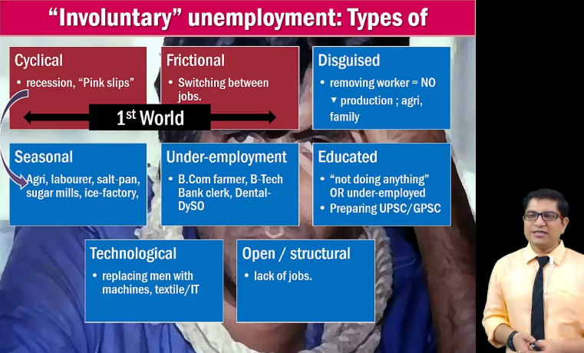
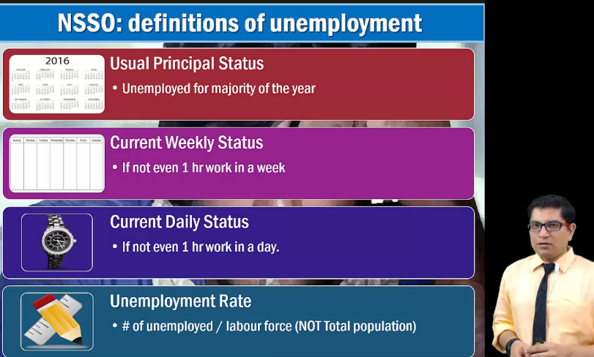
Labour welfare: Unemployment
Self study- BES164: unemployment theory
LINK

Slide 17
Why Make in India?
Why Skill?
How to Skill?
Dem Div
Ministries & Schemes
Geology
Geography
Jeans to JETs
Energy, Mineral wealth
Tourism -> Tax Haven
East Asian Tigers, China
Saudi Arabia
Switzerland, Mauritius

Slide 18
Direct jump to high-end, high-skill mfg =Problem
Direct jump because
Electricity, infrastructure: “aid curse”, “resource curse” and Poor governance.
Factory, labour laws, compliance cost, EPFO “regulatory” cholesterol
Agrarian
Jeans
Jets/ services
Low skill mfg.
High-Skill
White collar
Blue collar
Fill this vacuum by Make in India
Notes:
Abundant unskilled cheap Labour….yes our Natural advantage.
Export Demand….yes
Later, the “experience” helps in high-end mfg & electronic goods- S.Korea, China et al.
But Make in India-direct jump to #3….difficult

Slide 19
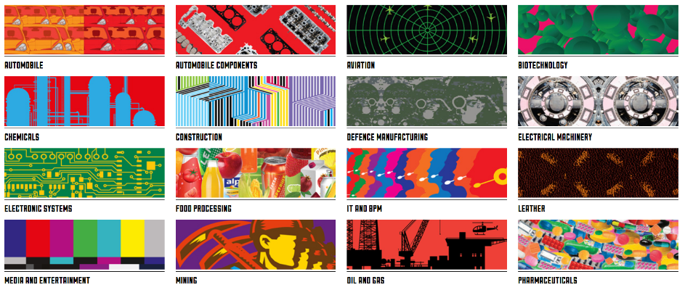
Comm Ministry->DIPP -> Make in India (2014), focus 25 sectors
National Mfg Policy (2011)
Mfg = 25% of GDP by 2022
100 million new jobs by 2022
NIMZ (investment and mfg. zone), ease of doing biz.
7 Years strategy, says IYB 2017

Slide 20

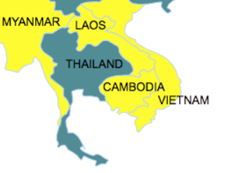
Comm Ministry->DIPP -> Make in India (2014), focus 25 sectors
Simplify Processes e.g. INC29
Open New Sectors (FDI)
Infra. ▲
IPR protection
Focus 30 25 Sectors
Good+ services
Comm Min-> “Twitter SEVA”
2015: Make Outside India under Act East Policy: CMLV…..From there, export to China (FTA)

Slide 21
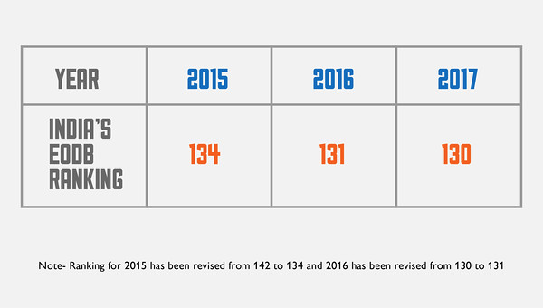
World Bank: Ease of Doing Biz. Did Make in India improve ranking?
Doing Business Report
World Bank
World Investment Report
UNCTAD
Global Competitiveness Report
World Economic Forum

Slide 22
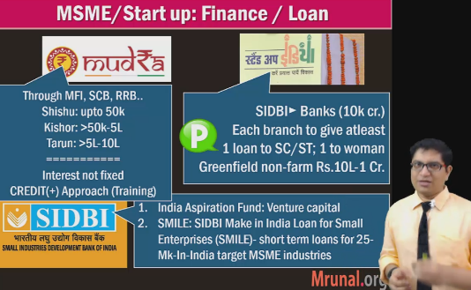
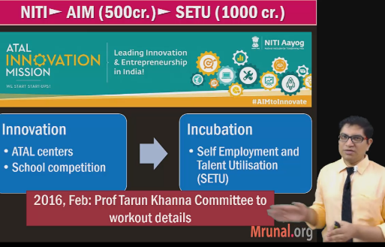
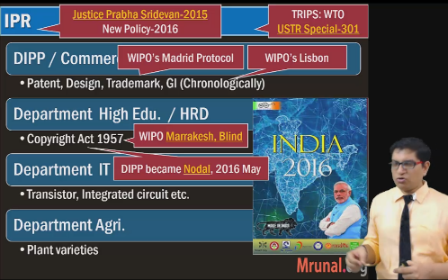
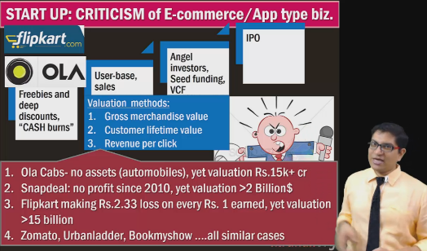
Innovation, STARTUP (SELF_STUDY) LINK

Slide 23

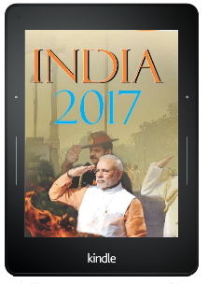

IYB 2017: regarding IPR & innovation
Ucchattar Avishkar Yojana (UAV)
Comm Ministry: SIPP
Scheme for startup IPR protection- fast tracking patenting
HRD Ministry: UAV, 2016
Dept of Sci-Tech: NIDHI, 2016
National Initiative for Developing and Harnessing Innovations (NIDHI)
Under that “PRAYAS” Centres for incubation
Dept of higher education-> IIT-> innovation

Slide 24
Mock Question for Prelims
Department of science technology implements which of the following schemes?
National Initiative for Developing and Harnessing Innovations (NIDHI)
Ucchattar Avishkar Yojana (UAV)
Visiting advanced joint research faculty scheme (VAJRA)
Answer Choices
a) Only 1 and 2 (b) Only 2 and 3
c) Only 1 and 3 (d) all of them
Hint: BoP->Current Account PPT, check again for PBD!

Slide 25
Make in India
Criticism
Mfg. not “inclusive”: Gujarat GSDP 1/5th comes from Mfg but only 1/20th people work there.
Still if done, then rich- coastal states will grow faster than poorer because of locational and demographic advantages.
Premature non-industrialization (direct jump to service sector without focusing on mfg), so infra, electricity problems.
Others can’t absorb all of our exports. Requires currency ‘undervaluation’, ‘Labour rights exploitation’ etc. like China

Slide 26
Mock Question for Mains GSM2 & 3
Since the industrial revolution, no country has become a major economy without becoming an industrial power. (Lee Kuan Yew) Examine the importance of “Make in India” in this regard.
“The future trajectory of Indian economic development depends on both Make in India and Skill India.” Elaborate
Inclusive growth necessitates greater focus on manufacturing than service sector. Do you agree?

Slide 27
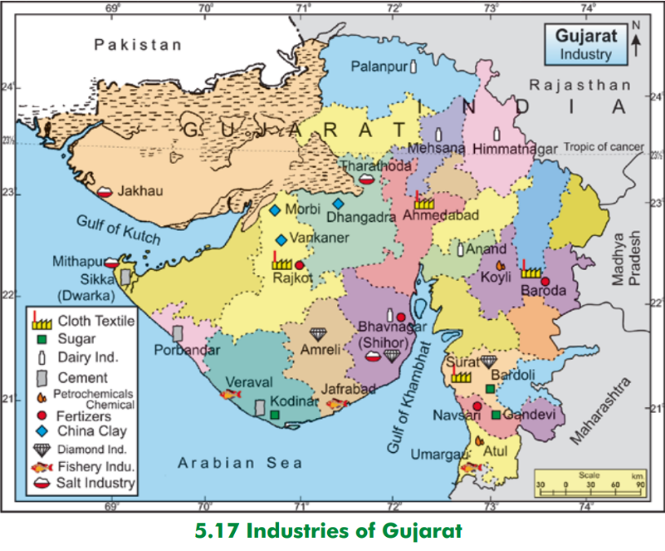
Sectors: 1) Agriculture 2) Mfg. Industries: Location factors?
Salt, Cement & Seafood: coastal?
Petrochem, Fertilizer= nearby why?
Textile, Dairy: landlocked dist ?
Location factors for Mains GS1 Article series: http://Mrunal.org/geography

Slide 28
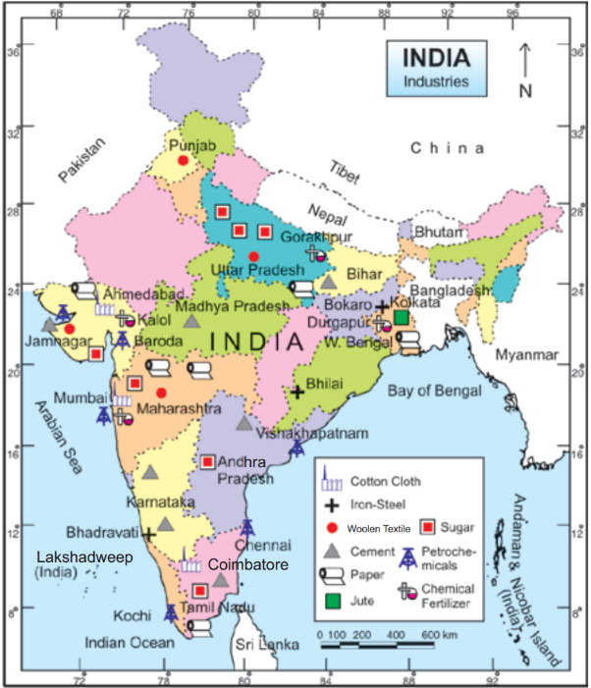
Petrochem, Fertilizer= nearby why?
Petrochem near coast?
Woolen, Textile, Iron Steel, cement - both landlocked & coastal?
Location factors for Mains GS1 Article series: http://Mrunal.org/geography

Slide 29
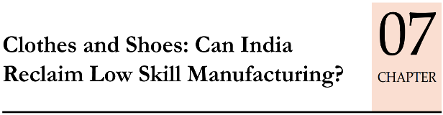
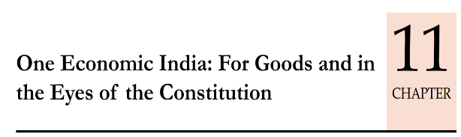
Economy: 6 pillars + theory + current + BES17 (pre cum Mains)
1.Banking, Fin, Insur.
6.HRD
2.Budget
3.BoP
4.Sectors
5.Infra
V1:c3,4
V1:c2,3, 6,9,11(GST),13
V1c:5
V1c:7(Textile),11(trade)
V1c:10
v1c:12, 14; Budget^Rail
11 pages bol-bachchan ► 12 slides
33 pages bol-bachchan ► 13 slides
And then GDP, IIP, CPI, WPI etc. “Indexes”
+ Demonetization impact on them.

